Slide 1
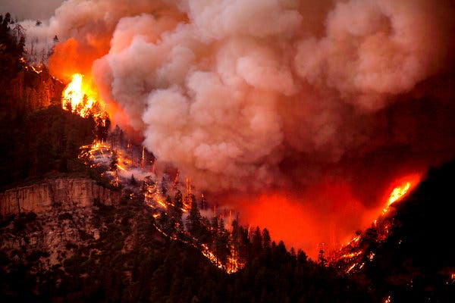

Custom Loss Functions for Fuel Moisture Models
Jonathon Hirschi
CU Denver
Fall 2023
Hermosa, Colorado 2018 (Source: NYT)

Slide 2
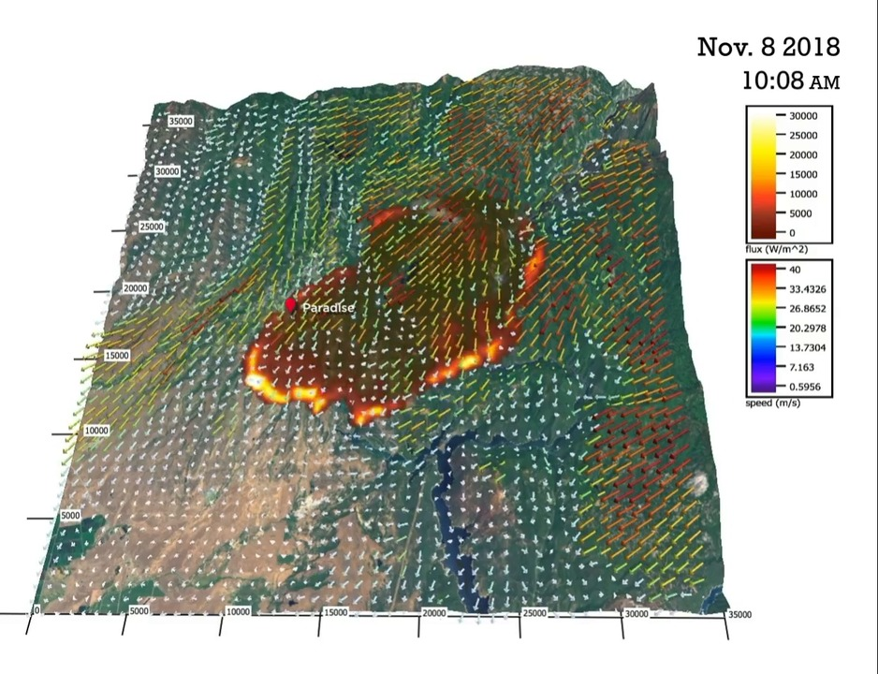
Wildfire Modeling: Motivations and Current Efforts
Wildfires are one of the main natural disasters faced by Americans. Climate change is projected to increase wildfire activity
Researchers are attempting to predict the behavior of wildfires with computational models
Traditionally, they use physics-based methods, but modern Machine Learning techniques are beginning to contribute to the field
NCAR Camp Fire Simulation

Slide 3
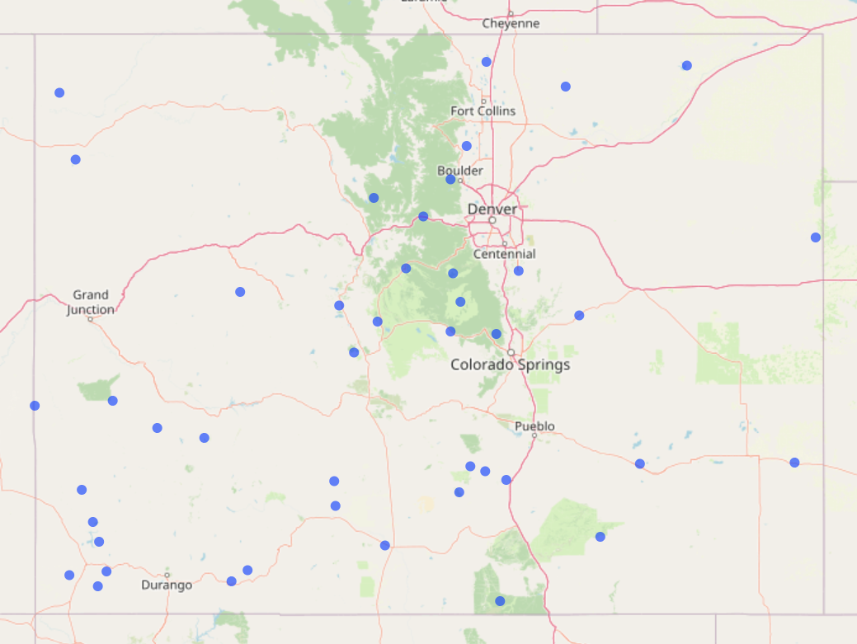
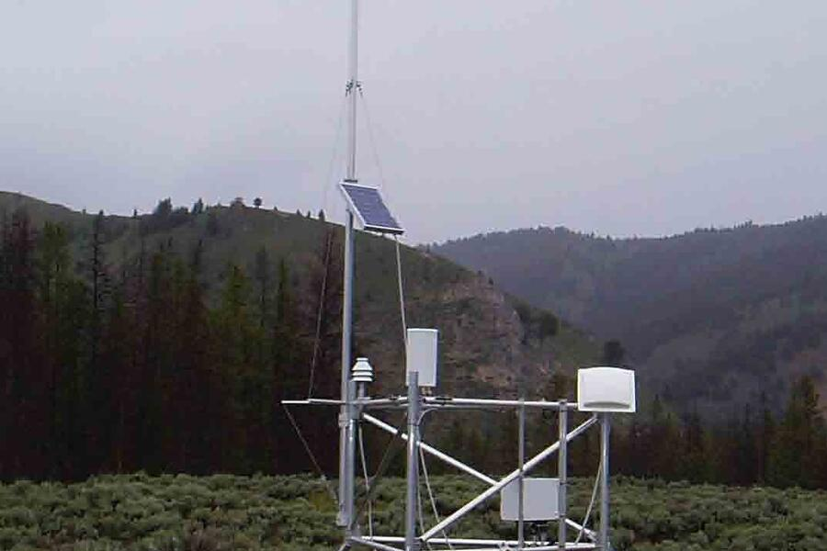
Fuel Moisture Content is a key input to wildfire models
Fuel Moisture Content (FMC) measures the water content of burnable fuels (expressed as a %)
NOAA operates Remote Automatic Weather Stations (RAWS) across the country to measure hourly FMC and other associated environmental variables.
Atmospheric data can come from RAWS stations or satellite data products and models
RAWS Monitoring Station
Map of CO RAWS stations (made with Leaflet in R)

Slide 4
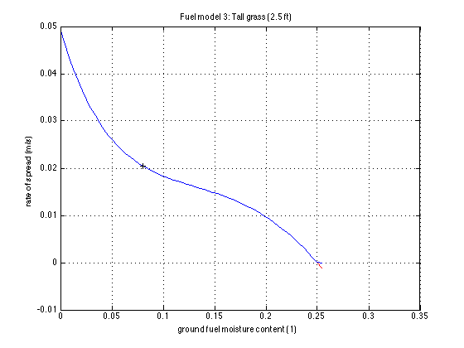
Fuel Moisture has nonlinear relationship with wildfire spread
Rate of Spread (ROS) is a measure of the speed at which a fire spreads from a point
Fuel moisture is one of the main drivers of ROS, but other variables like slope and wind affect it
Burnable fuels have an Extinction Moisture, where fire does not spread at all
Small differences in FMC at values near 0 lead to large difference in ROS
Source: Open WFM

Slide 5
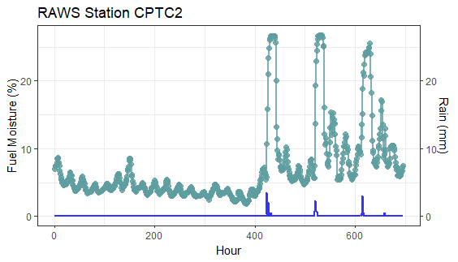
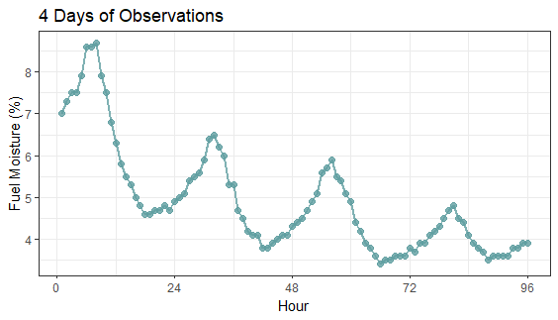
Training Fuel Moisture Models
If the goal is to get the most accurate rate of spread forecasts, why not train models directly on ROS?
Fuel Moisture is highly correlated in time
Even if two fuels have zero ROS, the FMC might be very different.
The temporal correlation of FMC means this information is still valuable to forecasting into the future
Custom loss functions could help compromise between training directly on FMC and ROS

Slide 6
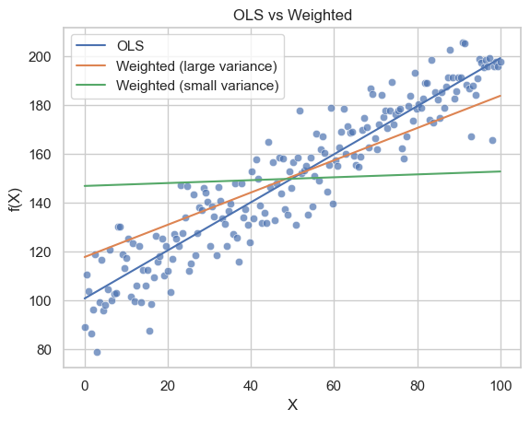
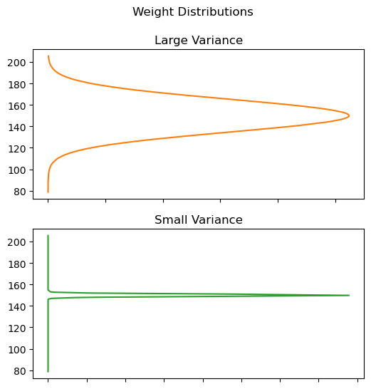
Custom Loss Functions Example

Slide 7
Proposed Experiment
Train several fuel moisture models using several different loss functions
Models include simple linear regression, autoregressive model, and physics-initiated RNN
Loss functions will vary from the extreme of OLS on fuel moisture to OLS on rate of spread. These loss functions would put more weight on low values of FMC without overfitting
Fuel moisture data will be from all 46 RAWS stations in Colorado from May-September (typical fire season) for 10-hour dead fuel moisture
Atmospheric data will come from the HRRR atmospheric model from NOAA.
Compare the accuracy of rate of spread forecasts for each loss function.
Investigate whether the different loss functions interact with model types differently
My hypothesis is that training directly on ROS will perform worse than directly on FMC, but a custom loss function that compromises between the two extremes will perform the best

Slide 8
Model Descriptions
Simple Autoregressive Model
Easily built and deployed.
“Physics-initiated” Recurrent Neural Network
Currently under research development.
Current physics-based Model
Does NOT use a loss function in the machine learning context.
Used for validation purposes.
The other models should perform within the same range of this model to be trustworthy.

Slide 9


Current Physics-Based Model
Model used within WRF-SFIRE
A simple Ordinary Differential Equation models wetting and drying of dead wood.
A finite-difference scheme is used to solve it.
Augmented Kalman Filter used for “data assimilation”

Slide 10
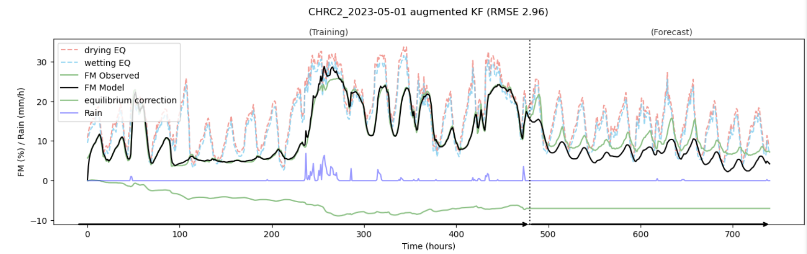
Augmented KF Example

Slide 11
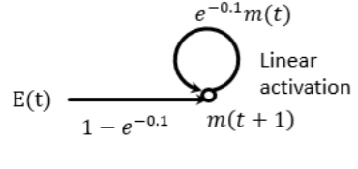
Physics-Initiated RNN
Initial weights to RNN set to solve previous ODE
RNN learns the data assimilation process through other network connections.

Slide 12
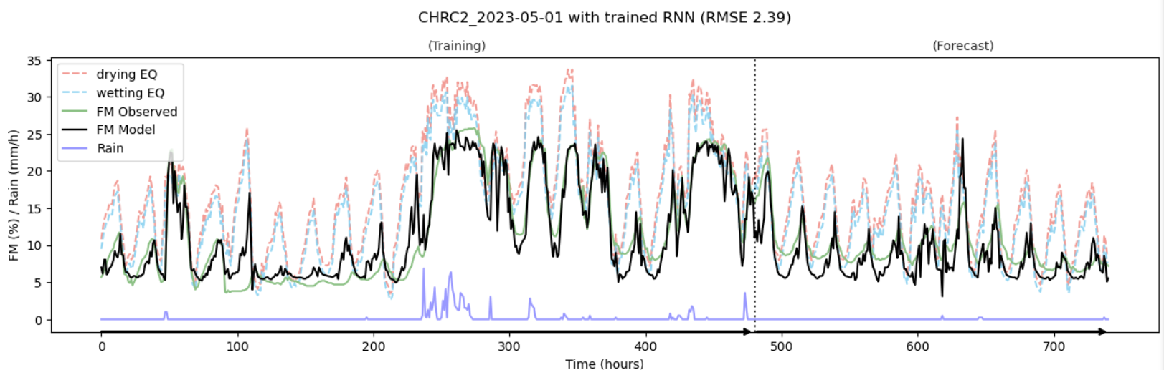
Physics-Initiated RNN Example

Slide 13

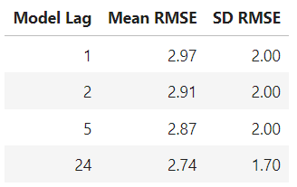
Autoregressive Model Background
Relates the response to values at previous times.
Mathematically like finite-difference schemes for differential equations.
Variable selection was performed using RMSE of forecasted values on a subset of the total FM data.

Slide 14
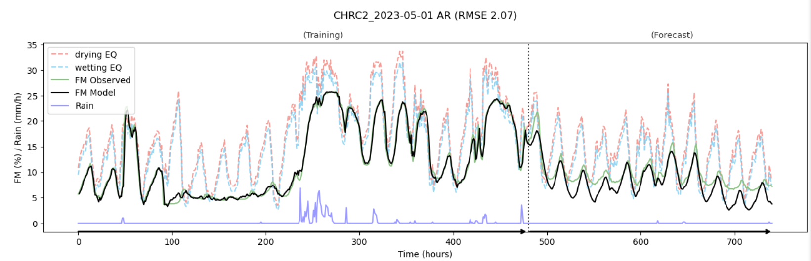
Autoregressive Model Example

Slide 15
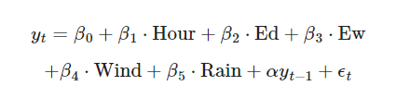
Final Autoregressive Model
Final Model specification utilized just lag 1.
It was within 1 standard error of the “best” model

Slide 16

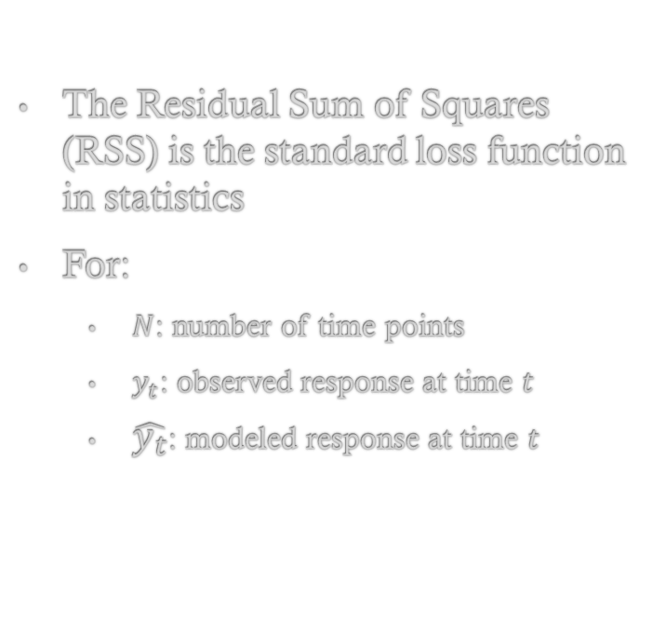
Standard Loss Function (1)
The Residual Sum of Squares (RSS) is the standard loss function in statistics
For:
$N$: number of time points
$y_{t}$: observed response at time $t$
$\hat{y_{t}}$: modeled response at time $t$

Slide 17
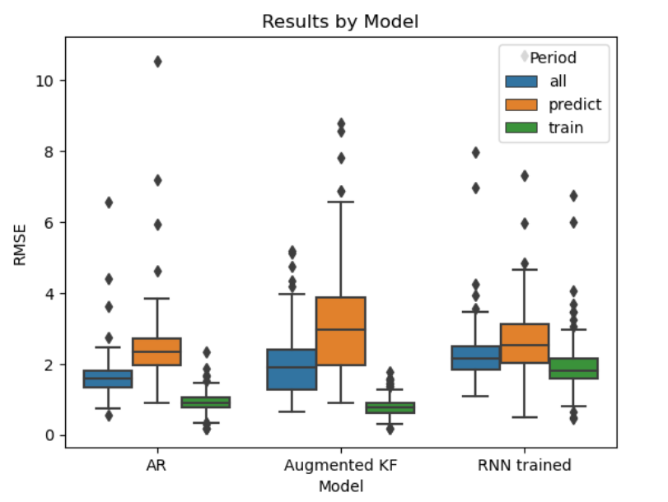
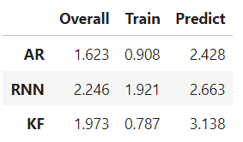
Running Models with Standard Loss Function
The AR model had the lowest prediction RMSE
The AR and Physics-Based KF model showed signs of overfitting
RMSE by Model and Training Period

